Slide 1

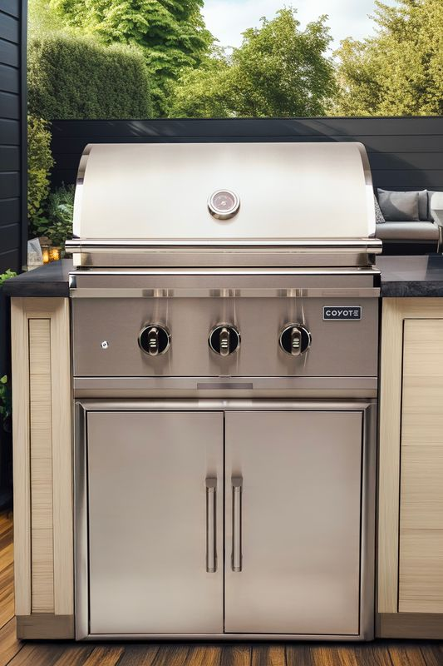
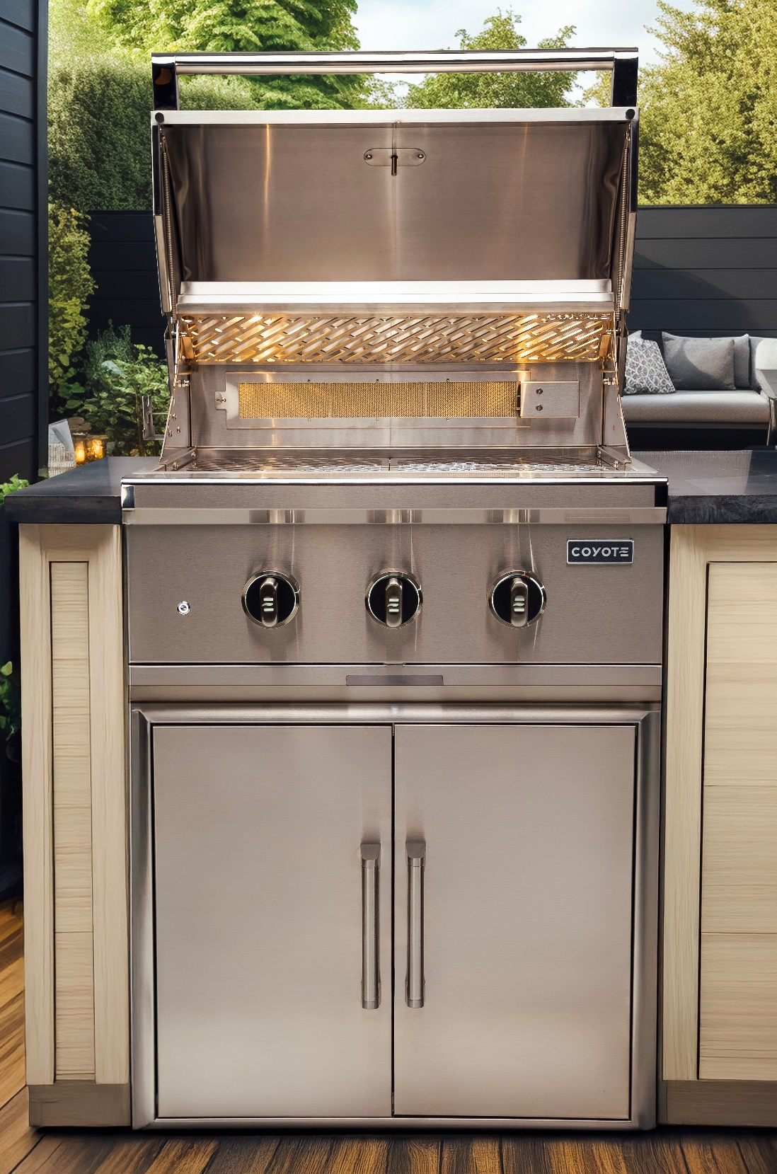
GEN 3 PRODUCT TRAINING

Slide 2
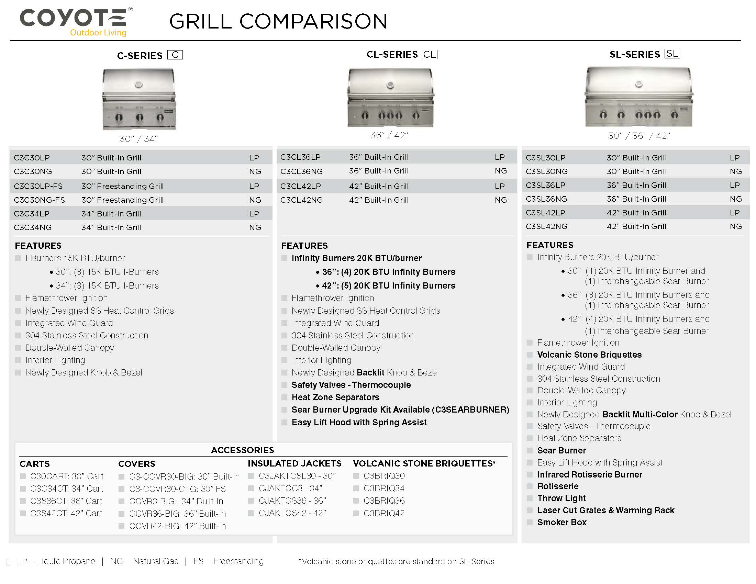

Slide 3

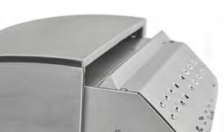
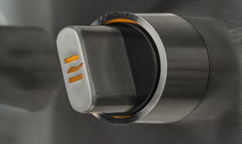
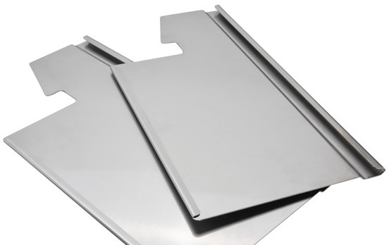
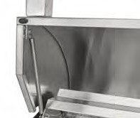
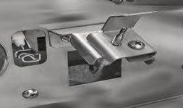
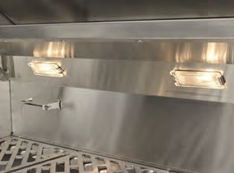

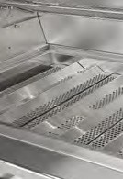
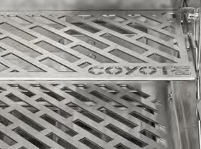
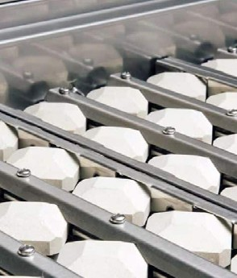
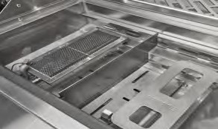
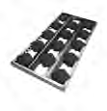
FEATURES
Integrated Wind Guard
Precision-Engineered Knob
Heat Zone Separators
Easy Lift Hood with Spring Assist
Safety Valve - Thermocouple
C
CL
SL
CL
SL
CL
SL
CL
SL
CL
SL
The Integrated Wind Guard (now featured on all Coyote grills) ensures consistent heat and performance, even in breezy conditions.
Experience ultimate control with the Precision-Engineered
Knob, crafted for smooth, precise adjustments. Designed to elevate your grilling performance, it provides a sleek, ergonomic feel and features a built-in light
(CL, SL-Series) for easy visibility, ensuring every cook is just the way you want it—day or night.
Heat zone separators are metal dividers between burners that create distinct temperature zones on a grill. (CL, SL-Series) They allow precise heat control, so
you can sear, slow-cook, or warm different foods at the same time without temperature overlap, improving versatility and efficiency.
The Easy Lift Hood, (CL, SL-Series) uses a spring-assisted mechanism, allowing you to open and close
the BBQ with minimal effort. It is designed for smooth, one-handed operation, making it effortless to access your BBQ.
The Safety Valve (CL, SL-Series) ensures peace of mind by allowing gas flow only when the flame is present. Designed for optimal safety, it automatically shuts off if the flame goes out, preventing gas leaks and ensuring a secure grilling experience every time.
Interior Halogen Lighting
Throw Light
Heating Grids & Ceramic Briquettes
Laser Cut Grate & Warming Rack
Interchangeable Sear Burner
C
CL
SL
SL
C
CL
SL
CL
SL
Illuminate your grilling space with Interior Halogen Lighting. Bright, energy-efficient, and strategically placed, it provides clear visibility inside the grill, so you can monitor your cook with ease—day or night.
Make a statement with the Coyote Logo Throw Light—projecting onto the ground in front of your grill. Not only adds a touch of flair, but it also illuminates your BBQ area with a unique and stylish glow. (SL-Series)
Stainless steel heat grids heat up quickly, providing even heat distribution for fast, efficient
cooking and easy cleanup. Ceramic briquettes retain heat longer, helping to create a more consistent cook and infuse a smoky flavor by vaporizing drippings back into your food. (C, CL-Series)
The Laser-Cut Grate (SL-Series) delivers sharp, clean lines for better heat retention and faster grilling.
The warming rack keeps your food warm and ready to serve, so you can enjoy flawless results from start to finish.
The SL-Series comes with a 15K BTU sear burner for high-heat precision, perfect for searing juicy, flavorful meats with intense heat. You can also add an infinity burner for versatile, all-purpose grilling.
The CL-Series doesn’t include a sear burner but offers it as an
upgrade. This customizable setup lets you grill your way—whether you’re locking in bold flavors or cooking at a steady pace.
(CL, SL-Series)
Volcanic Stone briquettes included with SL-Series

Slide 4
COYOTE MODEL TRANSITION
C1C28
C3C30
C2C34
C3C34
C2C36
C3CL36
C2C42
C3CL42
C2SL30
C3SL30
C2SL36
C3SL36
C2SL42
C3SL42

Slide 5
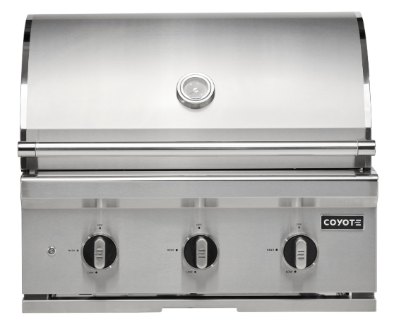
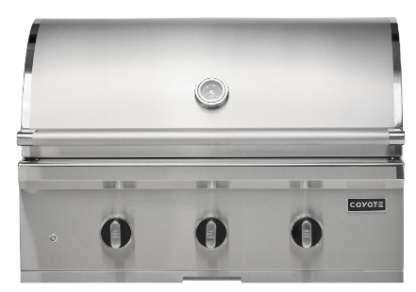
C-SERIES
30”
34”
C3C30
C3C34
FEATURES
3X I-Burners 15K BTU/burner
Flamethrower Ignition
Newly Designed SS Heat Control Grids
Integrated Wind Guard
304 Stainless Steel Construction
Double-Walled Canopy
Interior Lighting
Newly Designed Knob & Bezel
FEATURES
3X I-Burners 15K BTU/burner
Flamethrower Ignition
Newly Designed SS Heat Control Grids
Integrated Wind Guard
304 Stainless Steel Construction
Double-Walled Canopy
Interior Lighting
Newly Designed Knob & Bezel

Slide 6
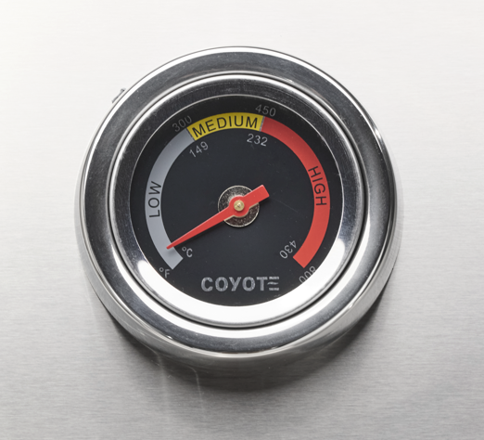
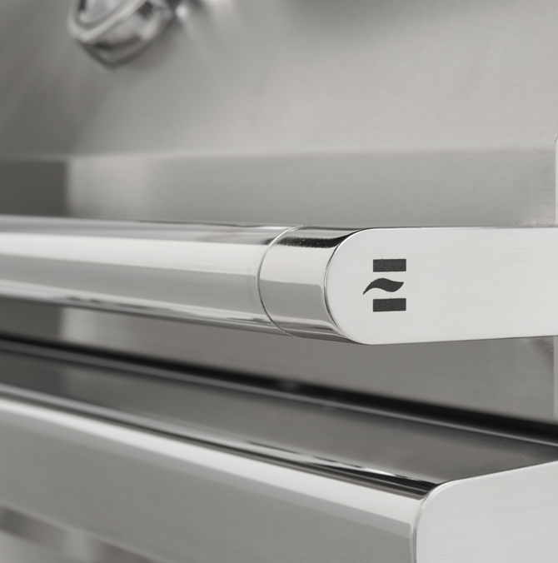
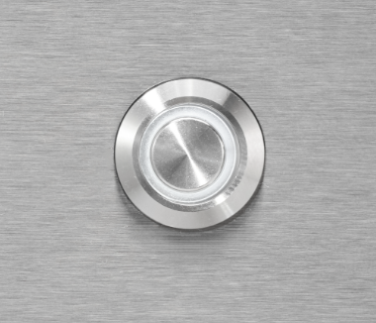
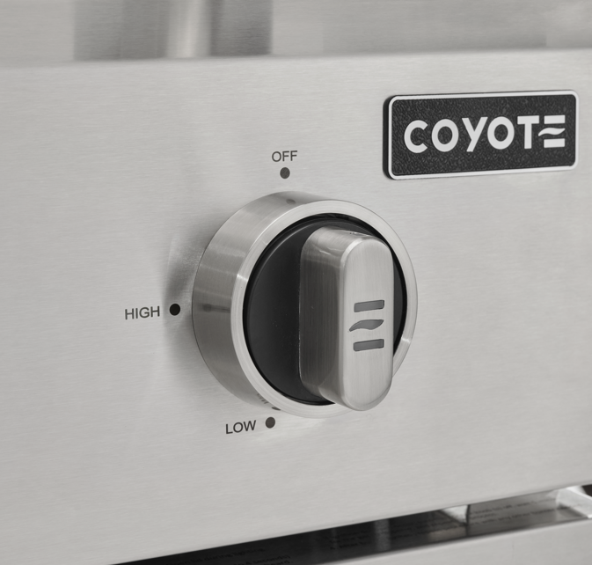
C-SERIES EXTERIOR
FEATURE:
Analog Temp Gauge
FEATURE:
Newly Designed Handle
FEATURE:
Interior Light Switch
FEATURE:
Newly Designed Knob & Bezel
ADDITIONAL FEATURES:
304 SS Construction
Double Walled Hood
Drip Tray
Smudge Proof Control Panel

Slide 7
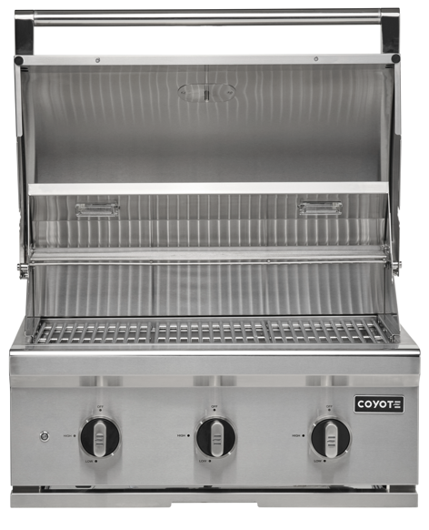
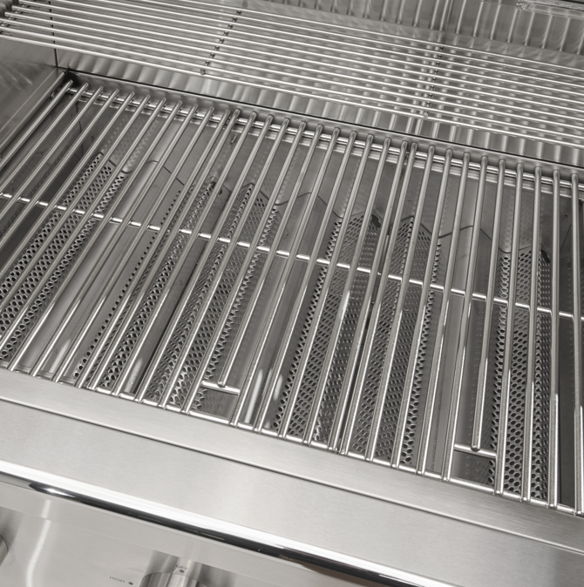
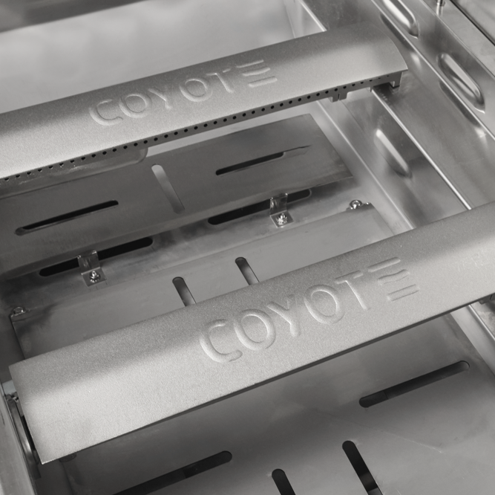
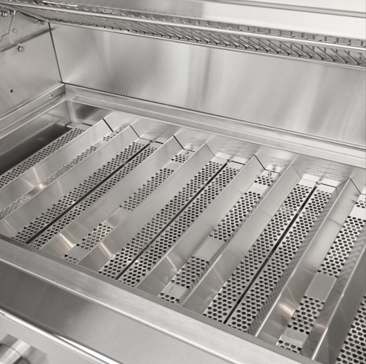
C-SERIES INTERIOR
FEATURE:
Halogen Lighting
FEATURE:
304 SS Rolled Grates
FEATURE:
15K BTU I-Burners
FEATURE:
Newly Design Heat Grids
ADDITIONAL FEATURES:
Flame Thrower Ignition
Integrated Wind Guard
Heat Zone Separators Available

Slide 8
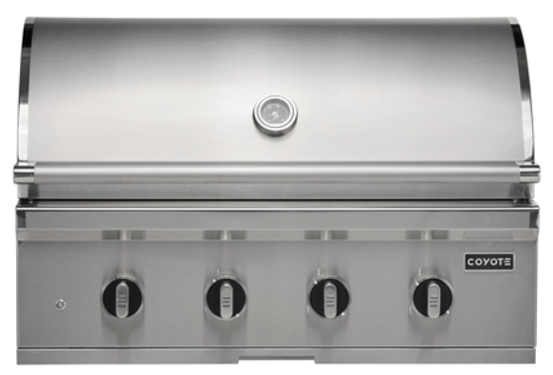
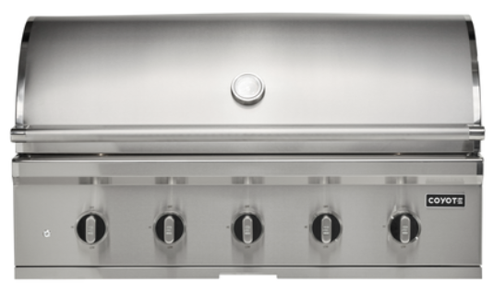
CL-SERIES
36”
42”
C3CL36
C3CL42
FEATURES
4x Infinity Burners 20K BTU/burner
Flamethrower Ignition
Newly Designed SS Heat Control Grids
Integrated Wind Guard
304 Stainless Steel Construction
Double-Walled Canopy
Interior Lighting
Newly Designed Knob & Bezel w/ Solid Light
Safety Valves - Thermocouple
Heat Zone Separators
Sear Burner Upgrade Available (C3SEARBURNER)
Easy Lift Hood with Spring Assist
FEATURES
5x Infinity Burners 20K BTU/burner
Flamethrower Ignition
Newly Designed SS Heat Control Grids
Integrated Wind Guard
304 Stainless Steel Construction
Double-Walled Canopy
Interior Lighting
Newly Designed Knob & Bezel w/ Solid Light
Safety Valves - Thermocouple
Heat Zone Separators
Sear Burner Upgrade Available (C3SEARBURNER)
Easy Lift Hood with Spring Assist

Slide 9
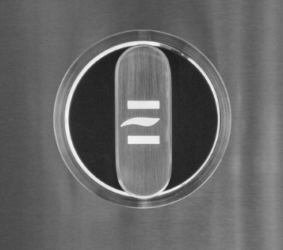
CL-SERIES EXTERIOR
FEATURE:
Analog Temp Gauge
FEATURE:
Newly Designed Handle
FEATURE:
Interior/Knob Light Switch
FEATURE:
Newly Designed Knob & Bezel (White Light)
ADDITIONAL FEATURES:
304 SS Construction
Double Walled Hood
Drip Tray
Smudge Proof Control Panel

Slide 10
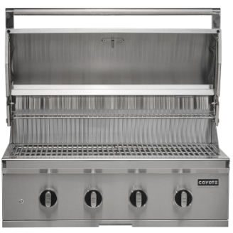
CL-SERIES INTERIOR
FEATURE:
Halogen Lighting
FEATURE:
EZ Lift Hood
FEATURES:
20K BTU Interchangeable Infinity Burners (Sear Burner Sold Separately)
Heat Zone Separators
FEATURE:
Newly Design Heat Grids
FEATURE:
304 SS Rolled Grates
FEATURE:
Safety Valve w/ Thermocouple
ADDITIONAL FEATURES:
Flame Thrower Ignition
Integrated Wind Guard

Slide 11
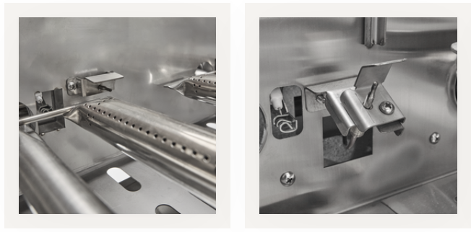
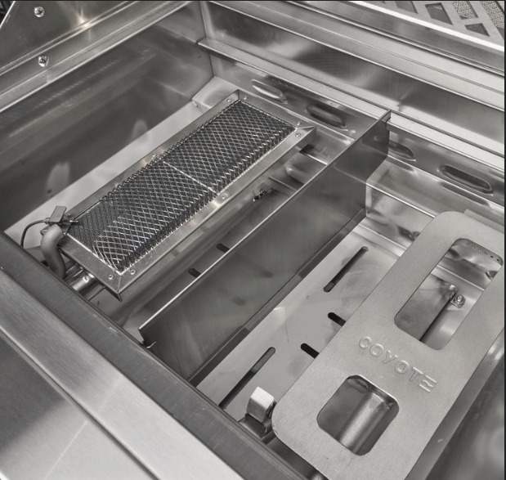
THERMOCOUPLE
Flat Top Thermocouple
Sear Burner Thermocouple
Infinity Burner Thermocouple

Slide 12
THERMOCOUPLE
Sales Training: Thermocouples on CL & SL Series Grills
Why Did We Add Thermocouples?
Thermocouples enhance safety and reliability by allowing gas to flow only when a flame is present. If the flame goes out, the thermocouple automatically shuts off the gas, preventing leaks and potential hazards.
How to Use the Thermocouple System
You can teach customers this simple 4-step process:
PUSH, TURN, HOLD, RELEASE.
1) PUSH - Press the control knob inward to start the gas flow.
2) TURN – Turn the knob until you hear a click, which indicates ignition.
3) HOLD - Keep the knob pressed for a few seconds to allow the thermocouple to heat up.
4) RELEASE - Once the thermocouple is heated, release the knob. The burner should stay lit.
Common Customer Issue & Solution
If the burner won't stay lit, customers may not be holding the knob long enough for the thermocouple to engage.
Next Steps for Sales Team
• Demonstrate this process on the showroom floor.
• If a customer asks, explain that the thermocouple ensures the gas shuts off if the flame goes out.
• Use the PUSH, TURN, HOLD, RELEASE method in every sales conversation.

Slide 13
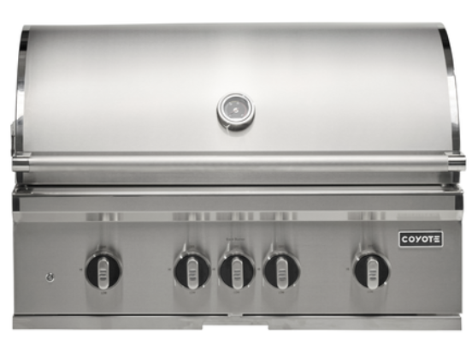
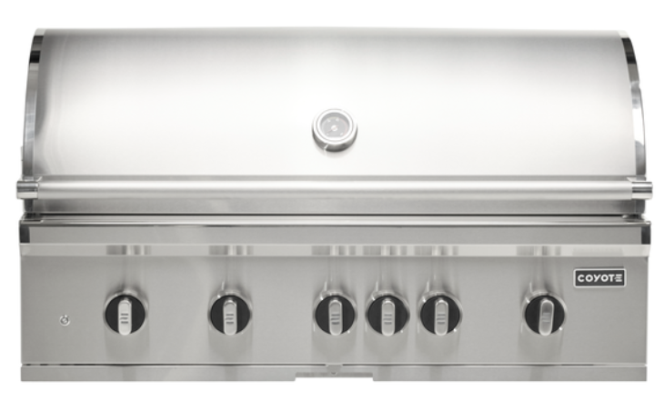
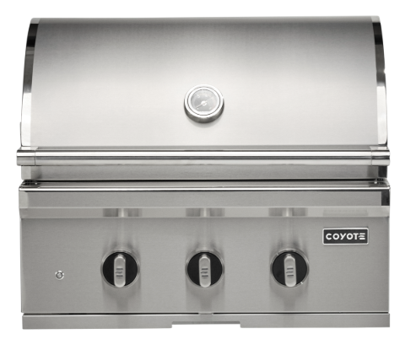
SL-SERIES
30”
36”
42”
C3SL30
C3SL36
C3SL42
FEATURES
1x Infinity Burners 20K BTU/burner
1x Infrared Rotisserie Burner
1x Sear Burner
Flamethrower Ignition
Volcanic Stone Briquettes
Integrated Wind Guard
304 Stainless Steel Construction
Double-Walled Canopy
Interior Lighting
Newly Designed Knob & Bezel w/ Multi Light
Safety Valves - Thermocouple
Heat Zone Separators
Easy Lift Hood with Spring Assist
Throw Light
Laser Cut Grates & Warming Rack
Rotisserie
Smoker Box
FEATURES
3x Infinity Burners 20K BTU/burner
1x Infrared Rotisserie Burner
1x Sear Burner
Flamethrower Ignition
Volcanic Stone Briquettes
Integrated Wind Guard
304 Stainless Steel Construction
Double-Walled Canopy
Interior Lighting
Newly Designed Knob & Bezel w/ Multi Light
Safety Valves - Thermocouple
Heat Zone Separators
Easy Lift Hood with Spring Assist
Throw Light
Laser Cut Grates & Warming Rack
Rotisserie
Smoker Box
FEATURES
4x Infinity Burners 20K BTU/burner
1x Infrared Rotisserie Burner
1x Sear Burner
Flamethrower Ignition
Volcanic Stone Briquettes
Integrated Wind Guard
304 Stainless Steel Construction
Double-Walled Canopy
Interior Lighting
Newly Designed Knob & Bezel w/ Multi Light
Safety Valves - Thermocouple
Heat Zone Separators
Easy Lift Hood with Spring Assist
Throw Light
Laser Cut Grates & Warming Rack
Rotisserie
Smoker Box

Slide 14
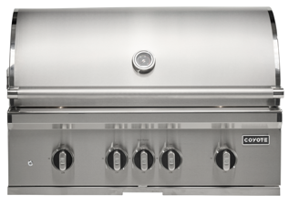
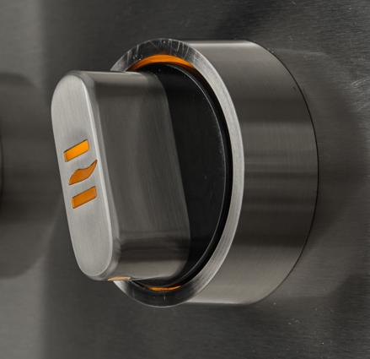
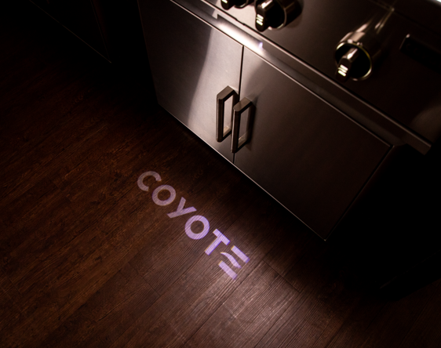
SL-SERIES EXTERIOR
FEATURE:
Analog Temp Gauge
FEATURE:
Newly Designed Handle
ADDITIONAL FEATURES:
304 SS Construction
Double Walled Hood
Drip Tray
Smudge Proof Control Panel
FEATURE:
Interior/Knob/Throw Light Light Switch
FEATURE:
Newly Designed Knob & Bezel (Multi Light)
FEATURE:
Throw Light

Slide 15
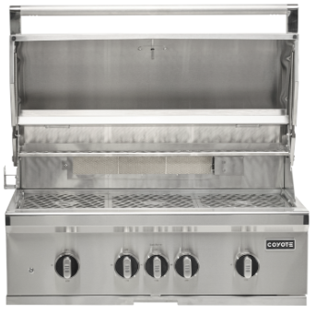
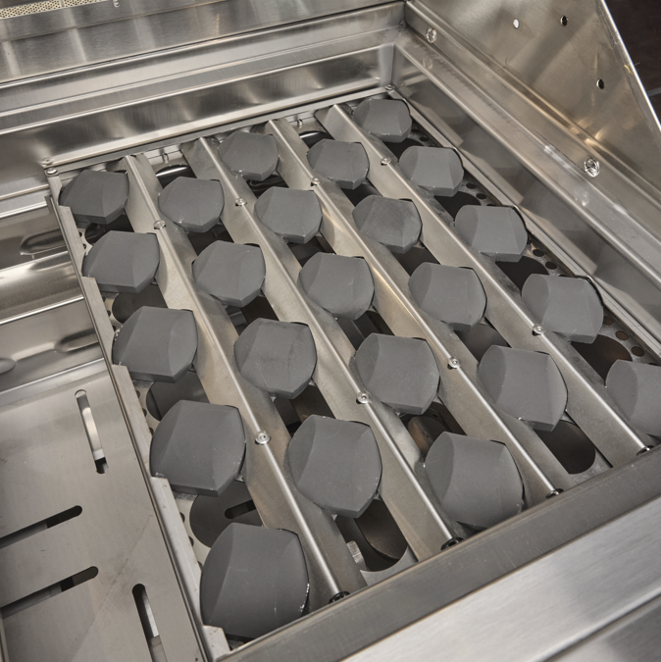
SL-SERIES INTERIOR
FEATURE:
Halogen Lighting
FEATURE:
EZ Lift Hood
FEATURES:
20K BTU Interchangeable Infinity Burners
15K BTU Sear Burner
Heat Zone Separators
FEATURE:
Newly Design Ceramic Briquettes
FEATURE:
304 Laser Cut Grates
FEATURE:
Safety Valve w/ Thermocouple
ADDITIONAL FEATURES:
Flame Thrower Ignition
Integrated Wind Guard
15K BTU Rotisserie Burner
Rotisserie & Smoker Box

Slide 16
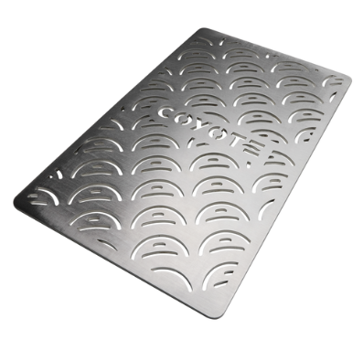
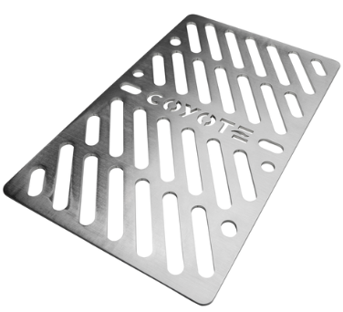
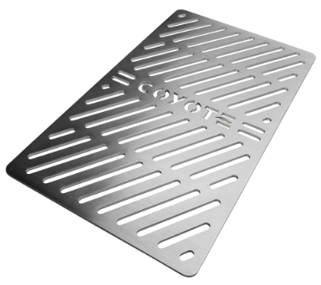
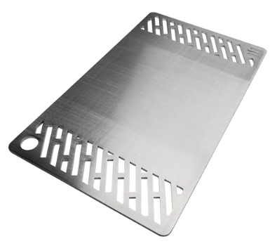
SIGNATURE GRATES
FEATURE:
Vegetable Signature Grate
FEATURE:
Beef Signature Grate
FEATURE:
Poultry Signature Grate
FEATURE:
Griddle Signature Grate

Slide 17
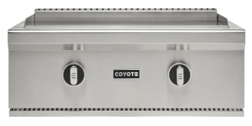
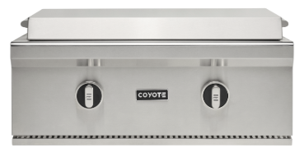
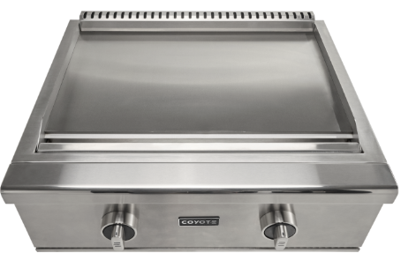
FLAT TOP GRILL
FEATURE:
Newly Designed Knob & Bezel (Multi Light)
Safety Valve - Thermocouple
C3FTG30LP 30” Built-In Grill LP
C3FTG30NG 30” Built-In NG
C3FTCART 30” Cart
FEATURES
2x U-Burners 17K BTU/burner
Flamethrower Ignition
Safety Valves - Thermocouple
304 Stainless Steel Construction
Stainless Steel Cover
Newly Designed Knob & Bezel w/ Multi Light
400 sq.in.
Removable Grease Trap
Two individually and accurately controlled heat zones

Slide 18
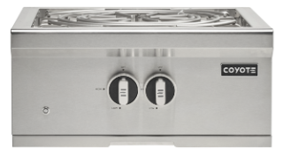
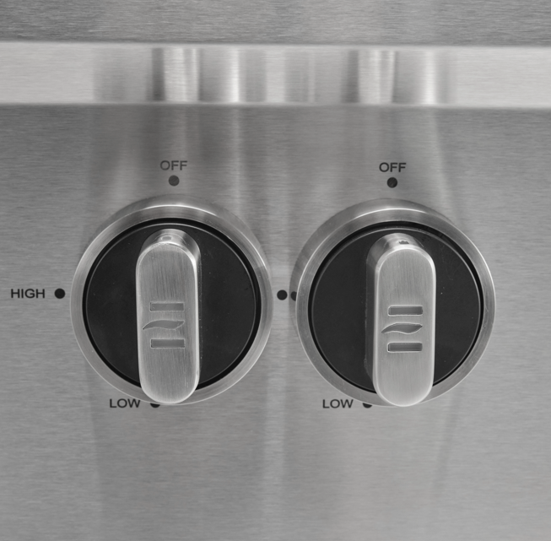
POWER BURNER
C3PBLP 24” Built-In Power Burner LP
C3PBNG 24” Built-In Power Burner NG
FEATURES
Dual Valve 60K BTU/burner
Flamethrower Ignition
304 Stainless Steel Construction
Stainless Steel Cover
Newly Designed Knob & Bezel w/ Light
Removable Grease Trap
FEATURE:
Newly Designed Knob & Bezel (Light)

Slide 19
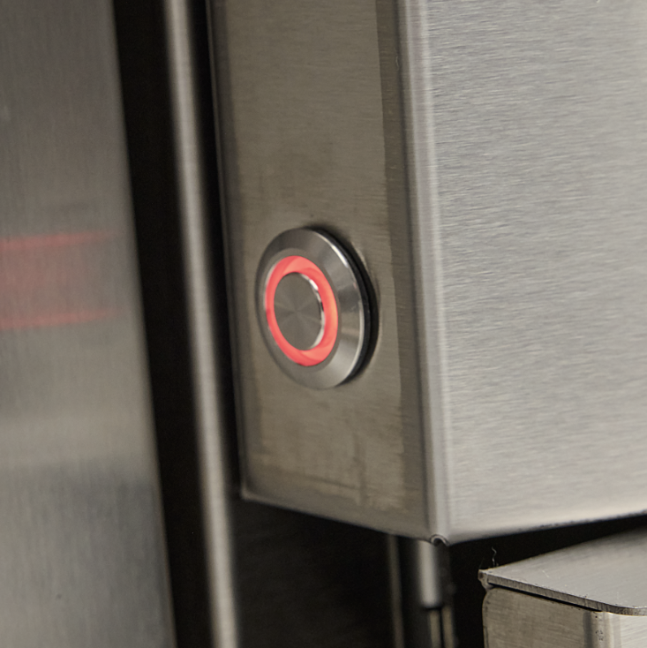
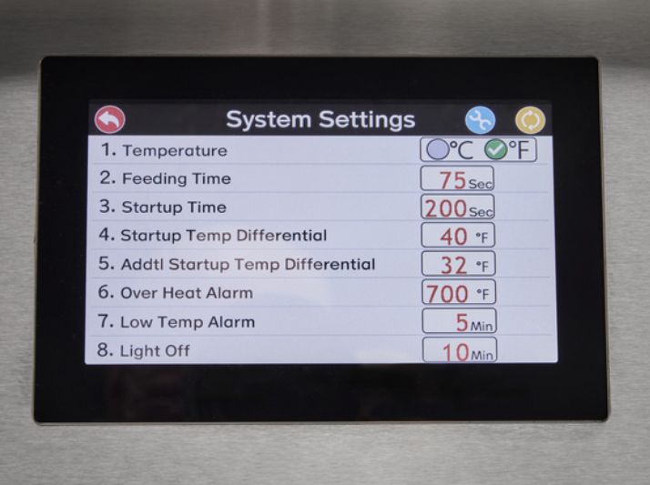
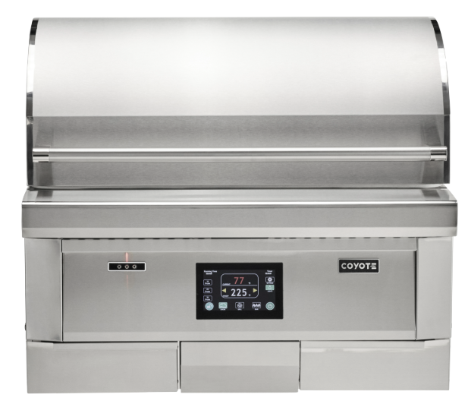


PELLET GRILL EXTERIOR
FEATURE:
Updated Font & New Animation @ Launch
C2P36
FEATURE:
Power button
C2P28
28” Pellet Grill
C2P36
36” Pellet Grill
C2P28-FS
28” Freestanding Pellet Grill
C2P36-FS
36” Freestanding Pellet Grill
FEATURES
Updated Animation & Font
Newly Designed Handle & End Cap
Versa Rack Storage Bracket
Intuitive digital touch control
Dual fan, auger & drip tray
Smart Drop™ pellet feed
Front loading pellet hopper
Spring assist hood
Double-walled canopy with gasket
Versa-Rack™ for multiple cooking surfaces
304 Stainless steel
Interior grill lighting
Led light for temperature probes
Laser cut grates
Built-in timer & wind guard
3 food temperature probes included
Individual smoke & sear grate included
Hopper capacity of 15 lbs.
Temperature range of 175°F – 700°F
Improvements: Burner Pot, Ignitor, Shute, Heat Shield, Temperature Accuracy, Smoke Output, Removable Power Cord, Added Gutter, Added Insulation For Electric, Air Gap, Grease Guide, Drip Tray Guard, Cooling Fan, & Surge protector
FEATURE:
Temp probe bracket
FEATURE:
Newly Designed Handle
D FS = Freestanding

Slide 20









PELLET GRILL INTERIOR
FEATURE:
Burner pot
FEATURE:
Grill/smoke grate
FEATURE:
Sear grate
FEATURE:
Heat shield
FEATURE:
Hopper
FEATURE:
Smoke seal
FEATURE:
Rain guard
FEATURE:
Ignitor

Slide 21

C3CO50 50” COMBO GRILL
FEATURES - GRILL
Grill: 2x Infinity Burners 20K BTU/burner
Flamethrower Ignition
304 Stainless Steel Construction
Newly Designed Knob & Bezel
Safety Valves - Thermocouple
Heat Zone Separators
Easy Lift Hood with Spring Assist
Stainless Steel Grates
600 sq. in.
Volcanic Stone Briquettes
Integrated Wind Guard
Double-Walled Canopy
FEATURES – FLATTOP
2x U-Burners 17K BTU/burner
Flamethrower Ignition
304 Stainless Steel Construction
Newly Designed Knob & Bezel
Safety Valves - Thermocouple
Flame Indicator
Food Guard
Easy Lift Cooking Surface
300 sq. in.
Stainless Steel Cover

Slide 22
COMBO GRILL EXTERIOR
FEATURE:
Analog Temp Gauge
ADDITIONAL FEATURES:
304 SS Construction
Double Walled Hood
Dual Drip Tray
Smudge Proof Control Panel
FEATURE:
Newly Designed
Handle
FEATURE:
Newly Designed Knob & Bezel

Slide 23






COMBO GRILL INTERIOR
FEATURE:
Easy Lift Hood with Spring Assist
Stainless Steel Grates
600 sq. in.
Volcanic Stone Briquettes
FEATURE:
304 Stainless Steel Construction
300 sq in
Flame Indicator Mirror
FEATURE:
Safety Valve w/ Thermocouple
FEATURE:
2x 17K BTU U-Burners
ADDITIONAL FEATURES:
2x Infinity Burners 20K
Heat Zone Separators
Integrated Wind Guard

Slide 24



ACCESSORIES
DOORS
DRAWERS
COMBO
C3-DA2426
26” Double Access Doors
C3-2DC
Two Drawer Cabinet
C3-CD2DC
45” Combo Storage
C3-DA2431
31” Double Access Doors
C3-3DC
Three Drawer Cabinet
C3-2DC31
31” Combo Storage
C3-DA2436
36” Double Access Doors
C3-SPRK
Spice Rack
C3-DA2439
39” Double Access Doors
C3-SA1420
14” X 20” Single Access Door
C3-SA2014
20” X 14” Single Access Door
C3-SA1724
17” X 24” Single Access Door
C3-SA2417
24” X 17” Single Access Door
FEATURES
304 Stainless Steel Construction
Soft Close Hinge
Extended Flange
Newly Designed Handle & End Cap
FEATURES
304 Stainless Steel Construction
Easy-Close Drawer Slides
Newly Designed Handle & End Cap
FEATURES
Doors:
304 Stainless Steel Construction
Soft Close Hinge
Extended Flange
Newly Designed Handle & End Cap
    Drawers:
304 Stainless Steel Construction
Easy-Close Drawer Slides
Newly Designed Handle & End Cap
D LP = Liquid Propane | NG = Natural Gas |

Slide 25



ACCESSORIES
FEATURE:
Soft close hinge
FEATURE:
Larger flange for easier installation
FEATURE:
Soft close hinge
FEATURE:
Newly designed handle to match grill
FEATURE:
Newly designed handle to match grill
FEATURE:
Soft close glide rails
FEATURE:
Newly designed handle to match grill
FEATURE:
Soft close glide rails

Slide 26





SINKS
FEATURE:
New pulldown faucet (cold only)
FARMHOUSE SINK
REFRESHMENT CENTER
C3-FHSINK
C3-RC
FEATURES
304 Stainless Steel Construction
Newly Design Faucet
Newly Designed Handle & End Cap
Farmhouse Apron Front Style
Drain, Strainer & SS Cover Included
FEATURES
304 Stainless Steel Construction
Newly Design Faucet
Newly Designed Handle & End Cap
Removable Condiment/Beverage Shelf
Towel Hook
Bottle Opener
21” SINK
C3-SINKF21
FEATURE:
New faucet with hot/cold
FEATURES
304 Stainless Steel Construction
Newly Design Faucet
Newly Designed Handle & End Cap
Drain, Soap Dispenser & SS Cover Included

Slide 27



REFRIGERATION
15” REFRIGERATOR
21” REFRIGERATOR
24” REFRIGERATOR
C115R-S
C121R
C124R-S
FEATURES
Reversible Hinge
LED Lighting
Stainless Toe Kick
Wire Racks
Digital Display
Door Lock
Door Sensor
Outdoor Rated
Adjustable Feet
Blk. Cabinet
FEATURES
Right or Left Hinge
LED Lighting
Stainless Toe Kick
Wire Racks
Digital Display
Door Lock
Forced Air Cooling
Automatic Defrosting
Outdoor Rated
Stainless Front, Back & Sides
FEATURES
Reversible Hinge
LED Lighting
Stainless Toe Kick
Wire Racks
Digital Display
Door Lock
Door Sensor
Outdoor Rated
Adjustable Feet
Blk. Cabinet

Slide 28


ICEMAKER & KEGERATOR
ICEMAKER
C115CICE
FEATURES
Crescent Ice
25lb Storage
Outdoor Rated
16lb Daily Production
Gravity Drain
Direct Cooling
KEGERATOR
C124KEG
FEATURES
All Stainless Exterior
Casters
Beer Tower & Tap Included
Guard Rail
Drip Tray
Fits 1/6, ¼ % ½ Keg
Digital Display
Surrounding Air Cooling System
Includes Racks
Outdoor Rated

Slide 29
THE END
THANK YOU!

